Slide 1
AI Generated Text (AGT) Detection
Research Papers analysis
By
Nidhi (22075054)
Shaunak Marathe (22075099)
Under the guidance of
Dr. Amrita Chaturvedi

Slide 2
Outline
Introduction
Motivation
Related Research
Methodology
Results
Conclusion
Future Work
References

Slide 3
Introduction
This project investigates state-of-the-art techniques for detecting AI-generated text (AGT) vs. human-written text (HWT).
Focuses on a comparative study of recurrent (LSTM, GRU) and Transformer-based (BERT) architectures.
Evaluates unidirectional vs. bidirectional processing and their impact on accuracy and efficiency

Slide 4
Motivation
Rise of advanced LLMs (e.g., GPT-4, Claude) makes AI Generated Text harder to detect.
Traditional methods (e.g., perplexity, lexical analysis) struggle with modern Large Language Models.
AGT can now mimic human tone, structure, and grammar almost perfectly.
Existing models either have high hardware constraints or high false positives, we aim to explore ways to minimize these.

Slide 5
Related Research
We present Transformer based models for research: AI generated text detection

Slide 6
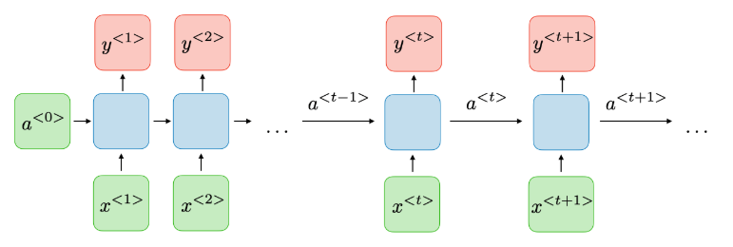
Recurrent Network Based Models

Slide 7
Detecting AI-Generated Text with Linguistic Features
Year: 2024
Dataset: HC3-English, GPT-3, GPT-4 texts
Features: (Linguistic) Readability, Complexity, Perplexity, Burstiness, Active/Passive voice scores
Models: CNN_BiLSTM, Roberta, RNNs
Best Accuracy: Roberta at 99.73%
Limitation: Increasingly difficult as AI improves (AI now mimics human nuances).

Slide 8
Human vs Machine: An Automated Machine-Generated Text Detection
Year: 2024
Dataset of human-written and LLM-generated texts
Features: Readability Score, Unique Word Score, Stop Word Score, Error Count, Human Phrases
Models: SVM, Random Forest, XGBoost, BiLSTM, distilBERT
Best Accuracy: DistilBERT with post processing: 87.5%
BiLSTM excelled at identifying human-written texts
Limitations: Feature set limited, recommends further exploration using various models.

Slide 9
Enhancing AI Text Detection: Bi-LSTM and Transformer Fusion
Year: 2024 (IEEE)
Dataset: Human and AI essays
Preprocessing: TF-IDF vectorization, SMOTE (Synthetic Minority Oversampling Technique) for class imbalance
Model: Bi-LSTM (captures local context) + Transformer (captures global context) Block fusion
Accuracy: 98%
Limitations: Requires larger datasets and balanced techniques like focal loss.

Slide 10
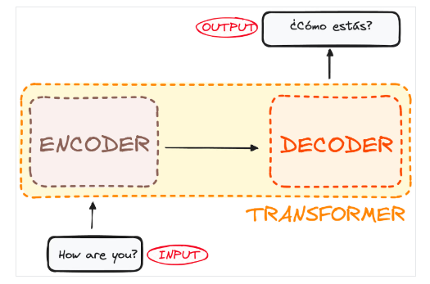
Transformer Based Models

Slide 11
Transformer-Based Ensemble for AI-Generated Text Detection
Year: 2023
Dataset: ALTA 2023 Shared Task
Model Ensemble: ALBERT, ELECTRA, Roberta, XLNet
Stacking transformers
Individually RoBERTa performed best
Best Accuracy of ensemble: 95.5%
Limitations: Computationally intensive, performance depends on base models.

Slide 12
RADAR: Robust AI-Text Detection with Adversarial Learning
Year: 2023 (IEEE)
Dataset: Synthetic adversarial dataset
Models: Detector (LLM) vs Paraphraser (LLM) in adversarial loop
Method: Detector detects Human Written Text or AI Generated Text, while Paraphraser rewrites AI text (to deceive the detector)
Accuracy: 91.3%
Limitations: High computational resource requirements, complex implementation.

Slide 13
Robust AI Text Detection via Restricted Embeddings
Year: 2024
Dataset: ATD and SemEval-2024
Method: Subspace removal in embeddings
Ignores misleading/unnecessary features for better generalization, filtered out noise
Accuracy Boost: 9% for Roberta, 14% for BERT
Limitation: Requires further validation across diverse domains.

Slide 14
AI-Generated Text Detection and Classification Using BERT
Year: 2024
Private dataset of AI-generated and human texts
NLP Preprocessing: Lowercasing, Tokenization, Stop-word Removal
Model: BERT with MLM (Masked Language Modeling) and NSP (Next Sentence prediction)
Accuracy: 94.78%
Limitation: Small dataset size limits, generalization, stop word removal can remove human phrases.

Slide 15
BISCOPE: AI Text Detection with Memorization Check
Year: 2024
Dataset: Code, essays, arXiv papers, Yelp reviews
AI Models: GPT-4, Claude, Gemini
Method: Bidirectional Cross-entropy loss on token predictions (forward & backward loss)
Detection F1 Score: 0.95
Limitation: Recommends further integration of contextual information(better exploitation of token info).

Slide 16
EssayDetect: Multilingual AI Essay Detection
Year: 2025 (COLING)
Dataset: Multilingual academic essays
Features: Stylometry, Linguistics, PLM (Pre-trained Language model) Embeddings, focal loss for imbalance, LIME (Local Interpretable Model-agnostic Explanations) for feature extraction
Best Model: DeBERTa/AraBERT (English: 0.978, Arabic: 0.9429)
Limitation: High false positive rates, struggles with linguistic nuances, different feature extraction like SHAP (SHapley Additive exPlanations).

Slide 17
Conclusion of Related research
Various models applied, from traditional Machine Learning to deep learning
Transformer-based models like BERT and Roberta dominate
Fusion/Hybrid/ensemble performed better than individual models
Bidirectional models performed better than unidirectional models
Adversarial learning explored for robustness
AI Generated Text are more predictable (deterministic) in context in both directions (forward and backward)

Slide 18
Combined Limitations
Dataset Constraints: Small datasets limit generalization
Computational costs: High complexity and hardware requirements
Feature Limitations: Extracted features may not be sufficient
Adversarial Resistance: Some models are vulnerable to evasion attacks
Cross domain robustness: Models may not generalize across different domains
AI Generated Text is constantly evolving, adapting to human writing style

Slide 19
Methodology of Implementation
Research Paper analysis

Slide 20
Brief
Classification Task [Binary - human written or AI generated]
5 models (4 RNNs + 1 Transformer)
RNN
LSTM, GRU, Bi-LSTM, Bi-GRU
Transformer: BERT
Unidirectional v/s Bidirectional performance
Comparison stats and analysis
Classification report, Accuracy Loss plots for visuals

Slide 21
Model = LSTM/GRU/Bi-LSTM/Bi-GRU
Doc2Vec Embedding
Model Layer 1
Model Layer 2
Model Layer 3
Model Layer 4
Sigmoid Classifier

Slide 22
BERT
BERT Tokenizer
BERT embedding layer
Encoder Layer
BERT classifier

Slide 23
Model - LSTM
Long-Short Term Memory network (type of RNN)
Captures long-range dependencies (memory)
Processes text sequentially
Documents are first encoded using Doc2Vec to capture global semantics.
The fixed-length embeddings are fed into a 4-layer stacked LSTM with dropout regularization.
The final output is passed through a sigmoid classifier to determine whether the text is AI- or human-generated.

Slide 24
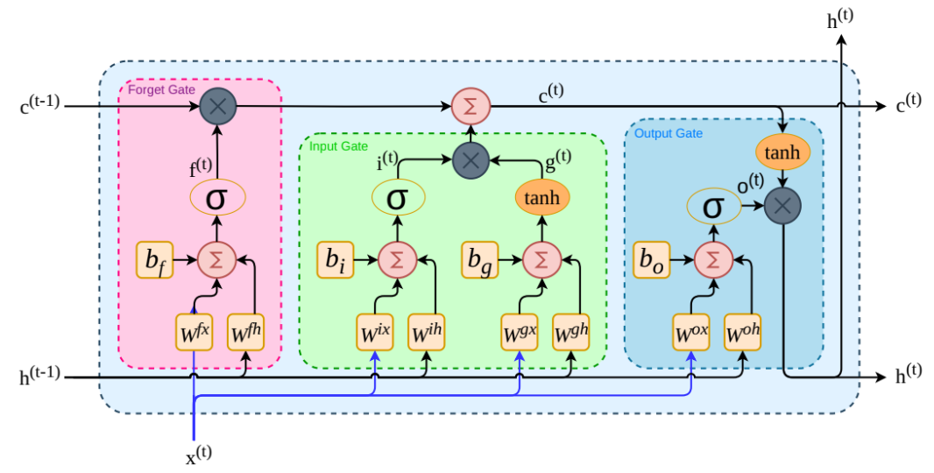
LSTM

Slide 25
LSTM

Slide 26
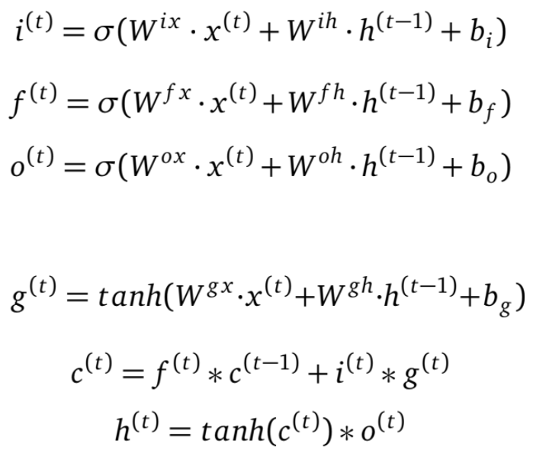
LSTM

Slide 27
Model - GRU
Gated Recurrent Unit (lightweight variant of LSTM)
Uses two gates:
Update gate: Decides how much past information to retain.
Reset gate: Determines how new input interacts with memory.
Documents are first encoded using Doc2Vec to capture global semantics.
The fixed-length embeddings are fed into a 4-layer stacked GRU with dropout regularization.
The final output is passed through a sigmoid classifier to determine whether the text is AI- or human-generated.

Slide 28
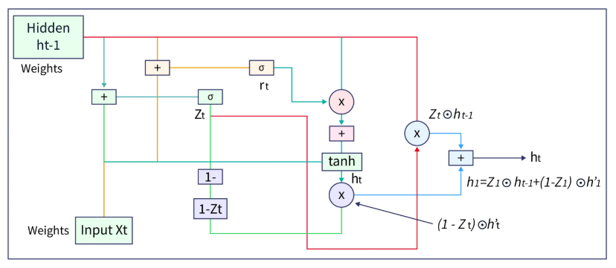
GRU

Slide 29
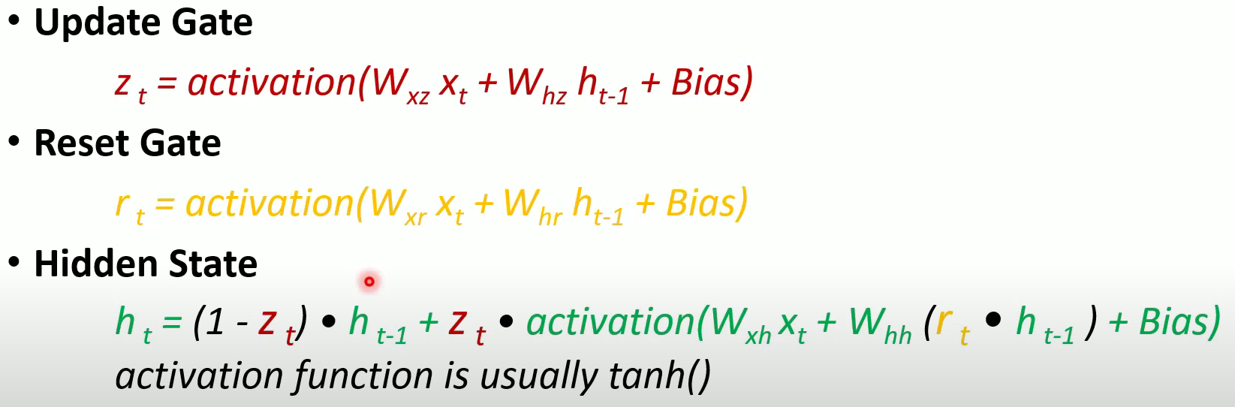
GRU

Slide 30
Model - Bi-LSTM
Bi-directional LSTM
Captures long-range dependencies in both forward and backward directions.
Processes text in both directions (forward and backward) to capture contextual information from both past and future.
Documents are encoded using Doc2Vec embeddings.
The fixed-length embeddings are fed into a 4-layer stacked Bi-LSTM with dropout regularization.
The final output is passed through a sigmoid classifier [AI-generated (1) or human-written (0)].

Slide 31
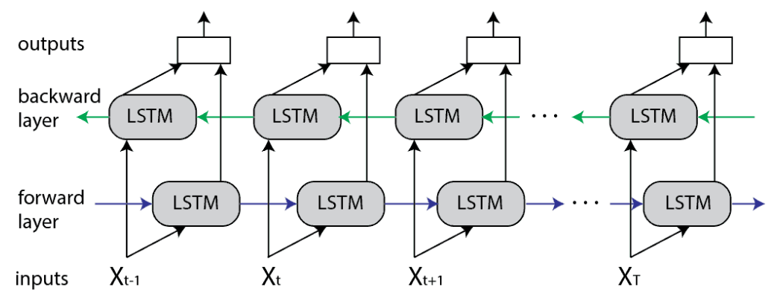
Bi-LSTM

Slide 32
Model - Bi-GRU
Bi-directional Gated Recurrent Unit
Captures long-range dependencies in both forward and backward directions using GRU units.
Processes text bidirectionally for improved contextual awareness while maintaining GRU's computational efficiency.
Documents are encoded using Doc2Vec embeddings.
The embeddings are passed through a 4-layer stacked Bi-GRU with dropout regularization.
The final output is passed through a sigmoid classifier

Slide 33
Model - BERT
Bidirectional Encoder Representations from Transformers
Captures bidirectional context using self-attention across the entire input sequence, unlike RNNs which process sequentially.
Utilizes pre-trained knowledge from large corpora through Masked Language Modeling (MLM) and Next Sentence Prediction (NSP) tasks.
Incorporates built-in embeddings (token, positional, and segment) to understand lexical, positional, and sentence-level structure.
Masked learning is learned based on context And Next sentence prediction is based on whether the sentences follow.

Slide 34
Model - BERT
The fine-tuned model includes a pre-trained BERT base with an added classification head (fully connected layer + sigmoid activation) for binary classification.
Fine-tuning is performed on a labeled dataset (0 = Human-Written, 1 = Machine-Generated) to specialize the model for AI text detection.

Slide 35
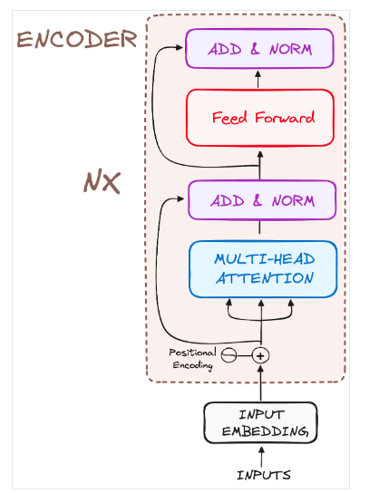
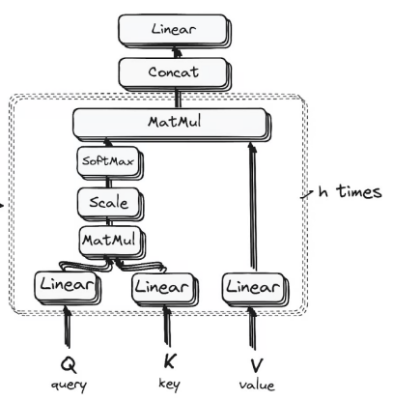
BERT
Multi-head self-attention

Slide 36
Results & Analysis
Plots, Classification report, and conclusion

Slide 37
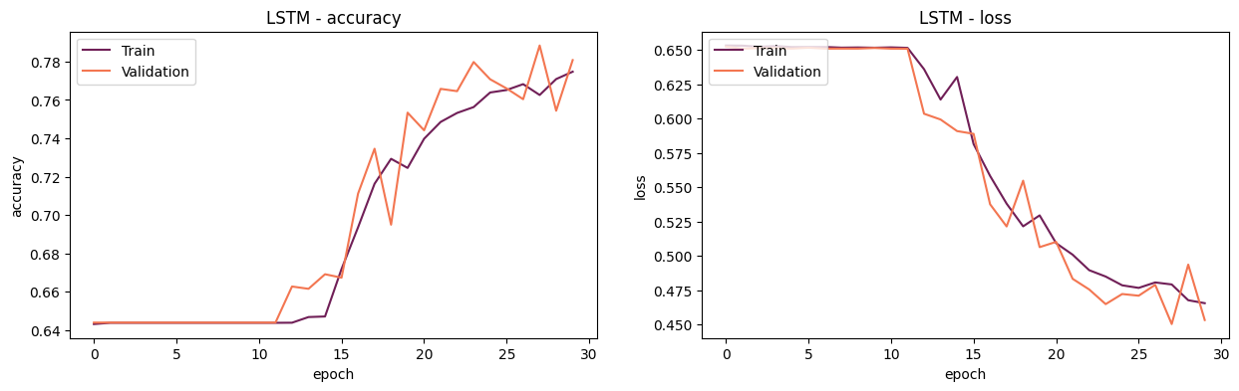
LSTM

Slide 38
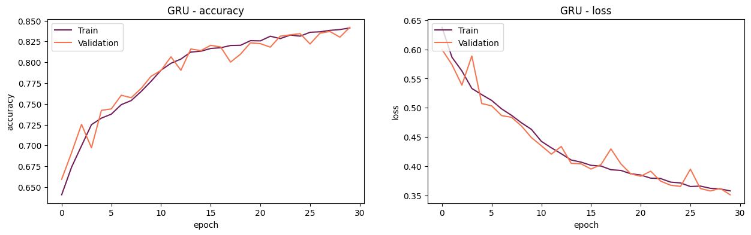
GRU

Slide 39
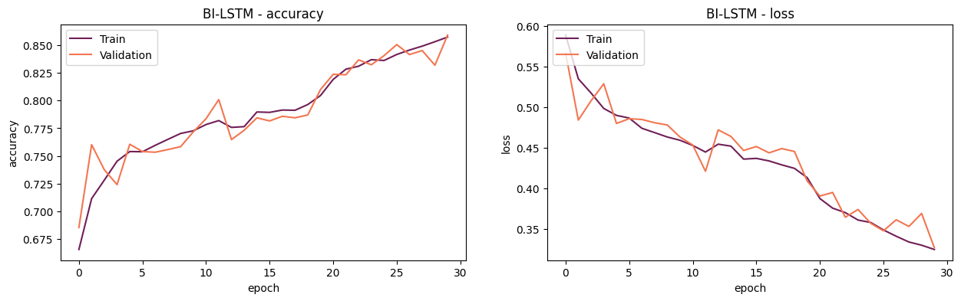
Bi-LSTM

Slide 40
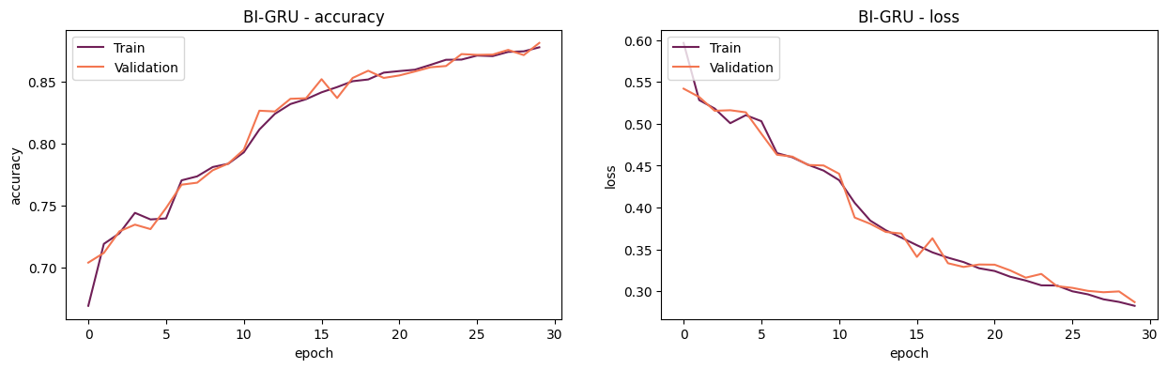
Bi-GRU

Slide 41
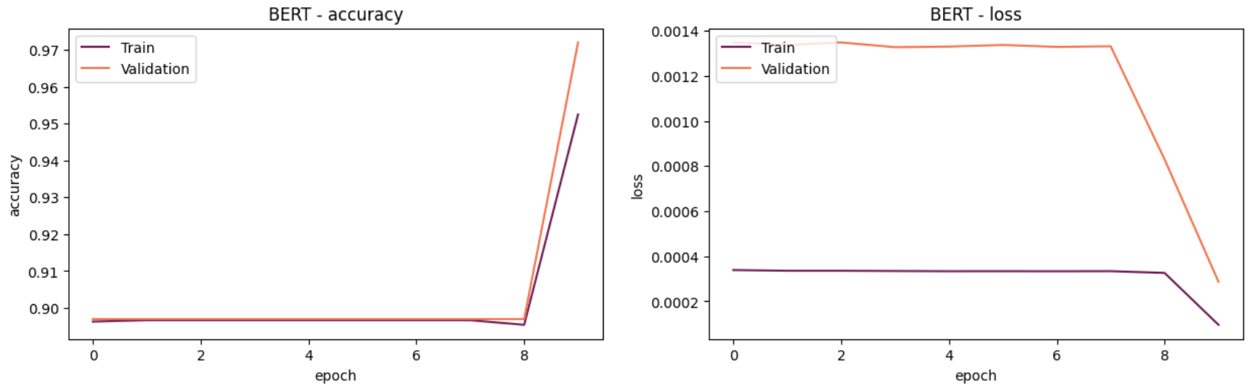
BERT

Slide 42
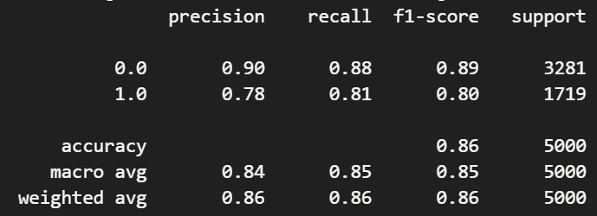
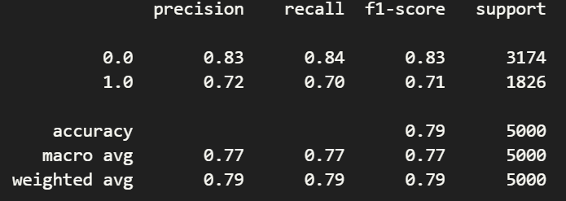
LSTM and Bi-LSTM
LSTM
Bi-LSTM

Slide 43
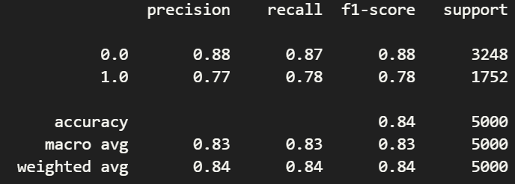
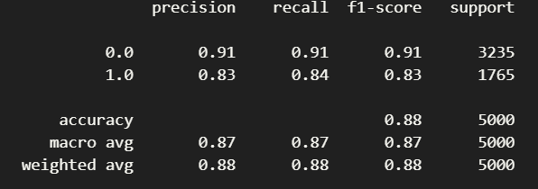
GRU and Bi-GRU
GRU
Bi-GRU

Slide 44
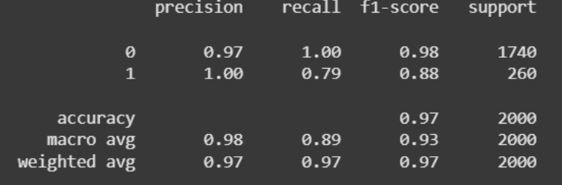
BERT

Slide 45
Results
Models | Accuracy | f1-score (c0) | f1-score (c1) | Notes
BERT | 97% | 0.98 | 0.88 | Excellent at detecting human-written text (c0); slightly lower recall for AI-generated text (c1)
Bi-GRU | 88% | 0.91 | 0.83 | Strong performance on both classes; well-balanced with slight edge in c0 detection.
Bi-LSTM | 86% | 0.89 | 0.80 | Good for both classes; marginally weaker than Bi-GRU in detecting AI-generated text
GRU | 84% | 0.88 | 0.78 | Decent overall; slightly biased towards human-written text.
LSTM | 79% | 0.83 | 0.71 | Struggles especially with AI-generated text; lowest performance across metrics.

Slide 46
Conclusion
Insights from the results, analysis

Slide 47
Conclusion
There’s a steady improvement in performance from LSTM → GRU → Bi-LSTM → Bi-GRU → BERT
Transformer model performed better than RNNs
Bidirectional performed better than their unidirectional variants
GRU outperformed LSTM, but inclusion of bidirectionality outperformed GRU
Bi-GRU has the most stable training curve in RNNs with minimal divergence between training and validation - good generalization

Slide 48
Conclusion
LSTM shows delayed learning while GRU and bidirectional shows faster learning
Bi-LSTM performed well, but Bi-GRU won in terms of structure simplicity and accuracy
Bi-directional models has faster convergence rate

Slide 49
Future Work
and
References

Slide 50
Future-work
Hybrid Architectures
Combine transformers (e.g., BERT) with lightweight models (e.g., Bi-GRU).
Adversarial Robustness
Study model resistance to paraphrased or obfuscated AGT.
Domain and Language Generalization
Improve cross-context and cross-language applicability.

Slide 51
Future-work
Deployment and Efficiency
Compress large models using distillation, or pruning. Develop parallelizable architectures for faster inference.
Alternative Architectures
Explore Informer models to handle long sequences efficiently (sub-quadratic complexity). Use Bi-GRU for short-term dependencies where full transformer context is unnecessary.

Slide 52
References
Stacking the odds: Transformer-based ensemble for ai text detection in Proceedings of the 21st Workshop of the Australasian Language Technology Association (ALTA), 2023.
Biscope: Ai-generated text detection by checking memorization of preceding tokens in Findings of EMNLP 2024.
Detecting ai-generated text with pre-trained models using linguistic features in Proceedings of ICON 2024.
Human vs machine: An automated machine-generated text detection approach in Proceedings of ICON 2024.

Slide 53
References
Essaydetect at genai detection task 2 in GenAIDetect 2025.
Ai-generated text detection and classification based on bert arXiv
Enhancing ai text detection: Embracing bi-lstm and transformer block fusion 2024
Radar: Robust ai text detection via adversarial learning in NeurIPS 2023.
Biscope: Ai-generated text detection by checking memorization of preceding tokens in NeurIPS 2024.
Robust ai-generated text detection by restricted embeddings in Conference Proceedings, 2024.

